Slide 1
Predicting the Existence of Dyslexia in Children Using fMRI
Presented by: Chen Cohen and Tom Beer
Supervised by: Yochai Blau
Clinical expert: Tzipi Horowitz-Kraus
Signal and Image Processing Lab
June 2016

Slide 2
Outline
Motivation & Agenda
Functional MRI
fMRI Data
ICA
Baseline
Next
Discussion

Slide 3
Motivation & Agenda
Project motivation – why detect Dyslexia using fMRI?
Current diagnosis lacks objective criteria.
Reading disorder is common to many psychiatric and neurological conditions, among them Dyslexia and ADHD. Accurate diagnosis is crucial for proper treatment.
fMRI provides accurate and consistent results for brain function, and has the potential to discriminate between reading disorders.
Project goals
Find active brain networks using non-linear algorithms
Detect Dyslexia using machine learning analysis
Motivation & Agenda
Functional MRI
fMRI Data
ICA
Baseline
Next
Discussion
Notes:
Currently, the diagnosis of dyslexia lacks objective criteria, which can decrease treatment efficacy. Diagnosis relies on a discrepancy between reading ability and intelligence, a measure which can be unreliable/ The current diagnosis for dyslexia focuses on lower accuracy and slower reading pace as compared to the expected level for the age, education, and intellectual abilities of the individual according to standardized norms. This definition relies on a discrepancy between intelligence and reading ability in individuals with dyslexia, even though the discrepancy model has been criticized for its poor validity. To date, there is still an ongoing controversy and variability in the definition of dyslexia, which has led to significant diversity in the presentation and diagnosis of this disorder. Furthermore, the multifaceted mechanisms involved in reading deficits challenge clinicians and researchers to provide accurate diagnoses for individuals with reading difficulty.

Slide 4
Functional MRI
fMRI is a neuroimaging technique used to map active brain areas responsible for performed tasks (such as thought, speech, movement, and sensation).
By measuring blood oxygen level dependent (BOLD) signal changes, fMRI detects active regions of the brain.
Increasing attention has been paid to how different parts of the brain connect, interact and coordinate with each other to perform a certain kind of cognitive function.
Motivation & Agenda
Functional MRI
fMRI Data
ICA
Baseline
Next
Discussion
Notes:
Functional connectivity is defined as the temporal dependency of neuronal activation patterns of anatomically separated brain regions and in the past years an increasing body of neuroimaging studies has started to explore functional connectivity by measuring the level of co-activation of resting-state fMRI time-series between brain regions.

Slide 5
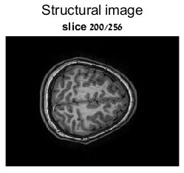
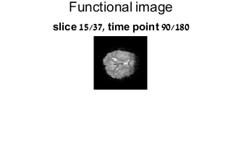
fMRI Data
Every study contains the structural images (256 slices of 192x256 images) and the functional information (37 slices of 64x64 images, practically 150K voxels, over 180 time points).
For example:
Motivation & Agenda
Functional MRI
fMRI Data
ICA
Baseline
Next
Discussion

Slide 6
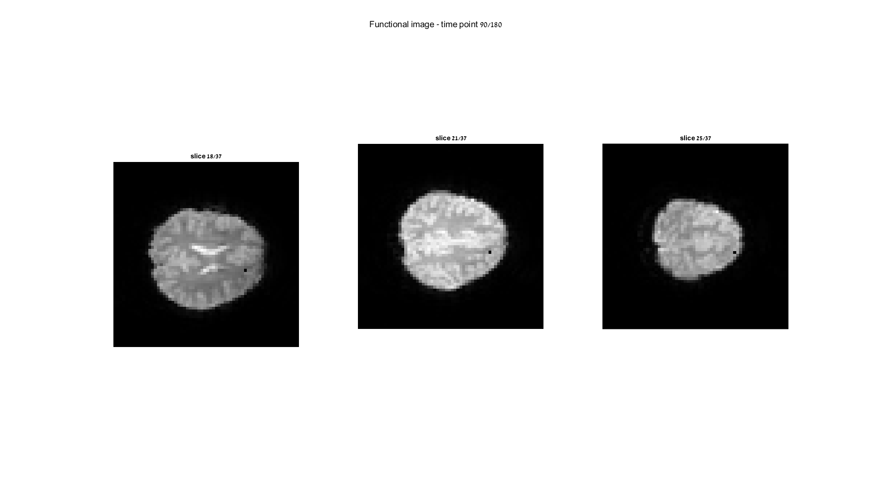
fMRI Data
Let’s take 3 different voxels in the functional image and present their temporal modulation – for example:
Pixel (38,46) in slices 18, 21 and 25:
Motivation & Agenda
Functional MRI
fMRI Data
ICA
Baseline
Next
Discussion

Slide 7
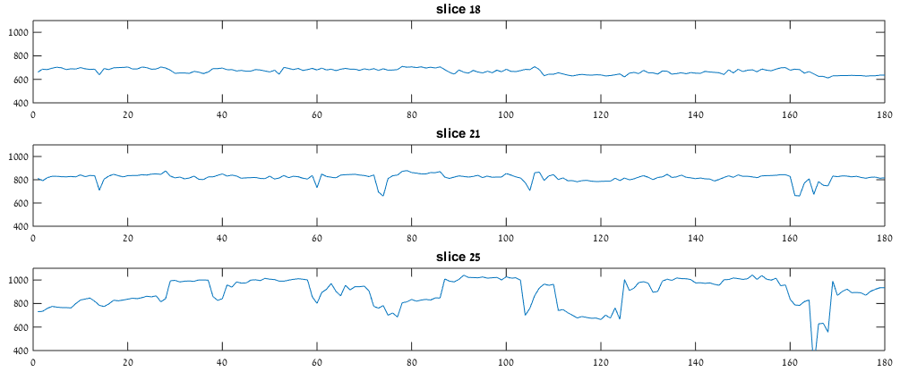
fMRI Data
The temporal modulation over 180 samples:
When we calculate the correlation we get that the pixels in slices 18 and 25 are un-correlated (0.06) while the pixel in slice 21 has significant correlation with both (~0.4).
Motivation & Agenda
Functional MRI
fMRI Data
ICA
Baseline
Next
Discussion

Slide 8
fMRI Data
Now, let’s look at a specific slice and explore the correlation between it’s pixels over time:
Slice 18
Slice 27
Motivation & Agenda
Functional MRI
fMRI Data
ICA
Baseline
Next
Discussion

Slide 9

Independent Component Analysis
Assume that the signals are a linear combination of independent components:
ICA finds the independent components and the mixing matrix A
This is done by maximizing independence measures (kurtosis, negentropy, etc.)
Many algorithms exist, the popular is FastICA
ICA is the leading tool to analyze functional brain activity
[van den Hauvel et al., 2010]
Motivation & Agenda
Functional MRI
fMRI Data
ICA
Baseline
Next
Discussion
Notes:
a statistical technique whose aim is to recover hidden underlying source signals from an observed mixture of these sources.

Slide 10
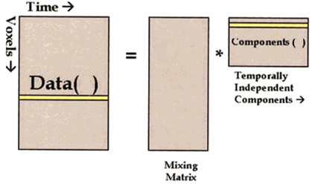
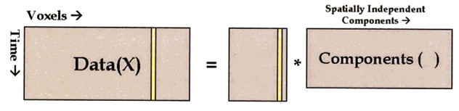
ICA of fMRI data – Spatial vs. Temporal
In our case, the independent components are brain networks (visual, auditory, default mode, etc.)
Two ways to organize the data lead to two distinct approaches: spatial ICA and temporal ICA
180
Temporal
S
A
150K
X
Spatial
150K
180
A
S
Motivation & Agenda
Functional MRI
fMRI Data
ICA
Baseline
Next
Discussion
Notes:
נקודה 2: להסביר שאחד נותן רכיבים ב"ת בזמן, ואחד במקום
לדעת להסביר את הדיאגרמות (להסביר שבאחד מחפשים temporal Ics ובשני spatial Ics)

Slide 11
ICA of fMRI data – Spatial vs. Temporal
sICA and tICA may produce similar results in some instances, and diverging results in others. In any case, neither of them is a priori superior over the other [Calhoun et al., 2001].
Due to the much higher number of voxels than time points in a typical fMRI scan, tICA is more computationally demanding and can easily lose practical feasibility.
Remedies could be found to overcome this obstacle (e.g. sparsification).
Motivation & Agenda
Functional MRI
fMRI Data
ICA
Baseline
Next
Discussion
Notes:
- נקודה 1: ולכן אולי חשוב להסתכל ולחקור את שניהם
http://ieeexplore.ieee.org.ezlibrary.technion.ac.il/stamp/stamp.jsp?tp=&arnumber=6098493
http://research.ics.aalto.fi/events/ica2000/proceedings/0543.pdf
https://arxiv.org/pdf/1012.0269.pdf
http://onlinelibrary.wiley.com.ezlibrary.technion.ac.il/doi/10.1002/hbm.1024/epdf

Slide 12
Baseline
Processing workflow, based on Tzipi’s research:
SPM
Motion Correction
Registration to Standard
GIFT
PCA – dimension reduction
GIFT
Matlab
Single-subject post processing
Temporal Concatenation Group ICA
GIFT
Backprojection
Motivation & Agenda
Functional MRI
fMRI Data
ICA
Baseline
Next
Discussion

Slide 13
Baseline
Motivation & Agenda
Functional MRI
fMRI Data
ICA
Baseline
Next
Discussion

Slide 14
Next
Soon:
Implement a non-linear dimension reduction as a pre-processing step for ICA
Implement a non-linear dimension reduction as a connectivity finding algorithm
Compare above methods to the Baseline results
Later on:
Detect Dyslexia using machine learning analysis
Finally:
Conclude with Tzipi’s expertise if we gained improvement
Motivation & Agenda
Functional MRI
fMRI Data
ICA
Baseline
Next
Discussion

Slide 15
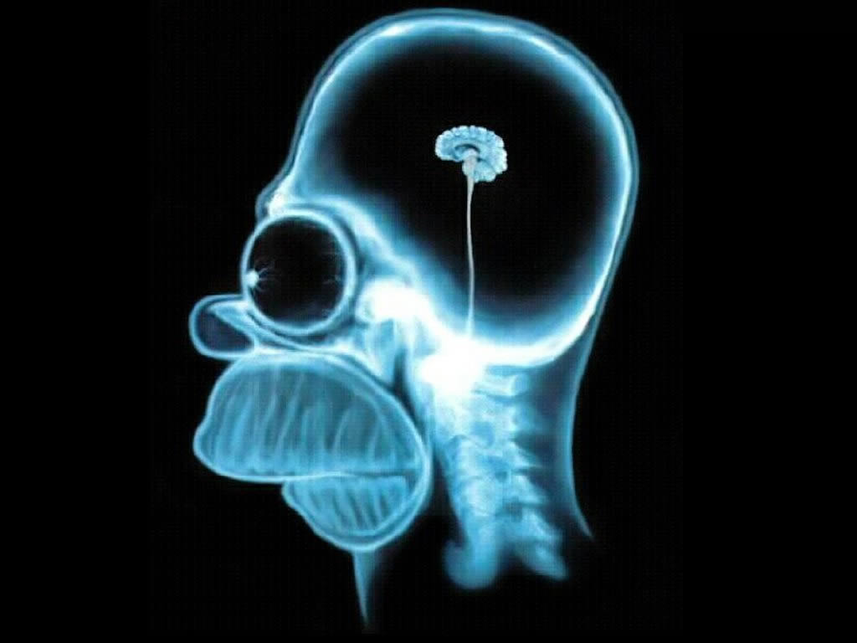
Discussion
Motivation & Agenda
Functional MRI
fMRI Data
ICA
Baseline
Next
Discussion

Slide 16
Non-linear Algorithms
Linear algorithms like ICA and PCA are based on the assumption of linear data mixing.
However, this may not be accurate for brain activity.
Studies have observed spatiotemporal nonlinearity in resting state fMRI BOLD signals [Xie et al., 2008].
A logical improvement would be to apply nonlinear dimensionality reduction, such as locally linear embedding and laplacian eigenmaps.

